Slide 1
Deep Q-Networks and Double DQN for Atari Breakout
Sarthak Nandwani
Course: Introduction to Deep Reinforcement Learning
Degree Program: M.Sc. Computer Science
Kiel University
23.06.2026

Slide 2
01
Project Objectives

Slide 3
Goal of the Project
Implement DQN and Double DQN
Train agents on Atari Breakout
Compare learning performance and stability
Investigate the impact of overestimation bias

Slide 4
Brief DQN Recap
DQN approximates Q-values using a neural network.
Uses:
Experience Replay
Target Network
Successfully learns from image observations.
State → CNN → Q-values → Action

Slide 5
02
Motivation for Double DQN

Slide 6
Problem: Overestimation Bias
DQN uses the same network to:
Experience Replay
Target Network
Can lead to overly optimistic Q-values.
May result in unstable learning.

Slide 7
03
Double DQN

Slide 8
Key Idea
Online Network selects action.
Target Network evaluates action.

Slide 9


Target Equations
DQN
Double DQN

Slide 10
04
Experimental Setup

Slide 11
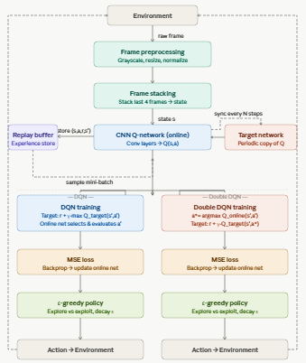
Implementation Overview
Components:
Frame preprocessing
Frame stacking
Replay buffer
CNN-based Q-network
Target network
DQN and Double DQN training

Slide 12
Model Architecture
Component | Details
Q-Network | CNN + Fully Connected Layers
Activation | ReLU
Output | Q-Values for each action
Target Network | Periodically updated copy of Q-Network

Slide 13
Training Hyperparameters
Hyperparameter | Value
Optimizer | Adam
Learning Rate | 1e-4
Discount Factor (γ) | 0.99
Batch Size | 32
Replay Buffer Size | 100K steps
Training Frequency | 4
Target Update Frequency | 1000

Slide 14
Exploration Strategy
Component | Details
Policy | ε - Greedy
Initial ε | 1.0
Final ε | 0.1
Decay Strategy | Linear Decay

Slide 15
05
Results after first 100K Steps
Linear decay of epsilon from 1.0 to 0.1

Slide 16
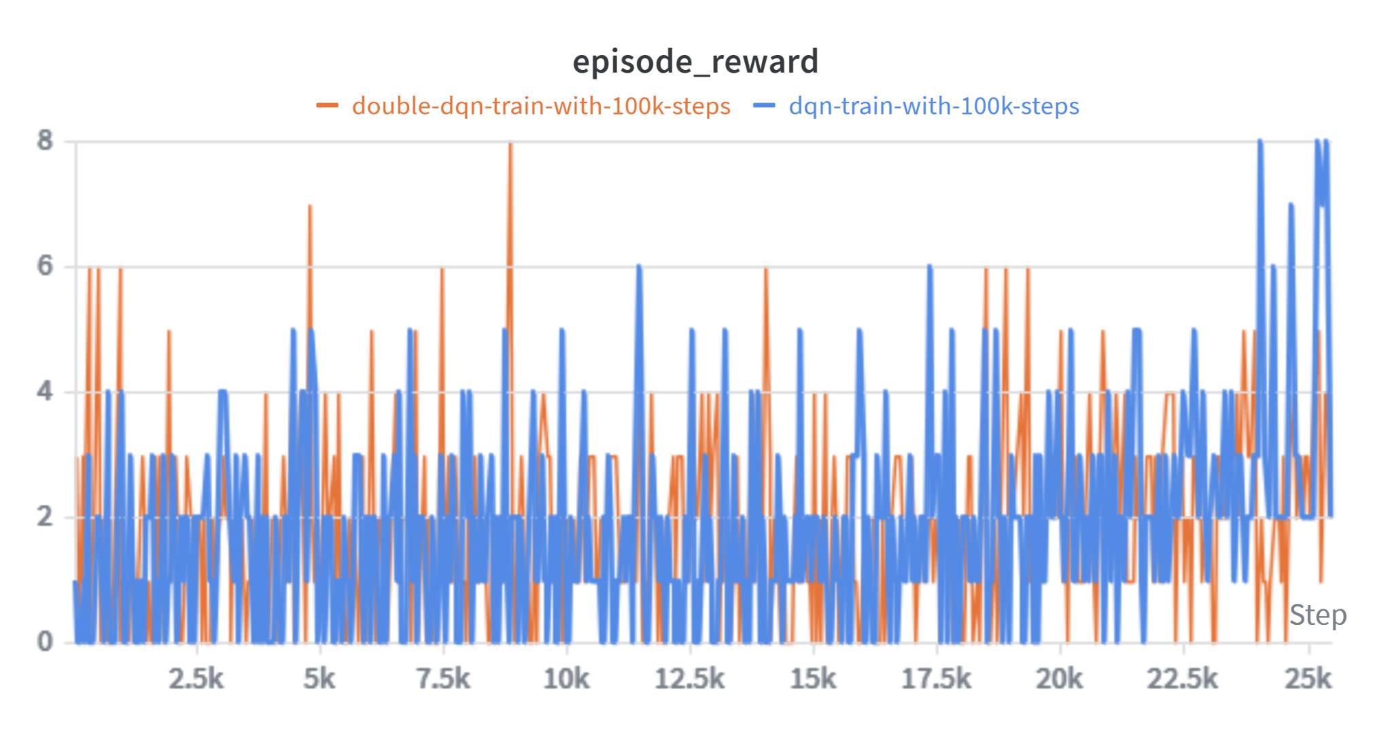
Reward Curves

Slide 17
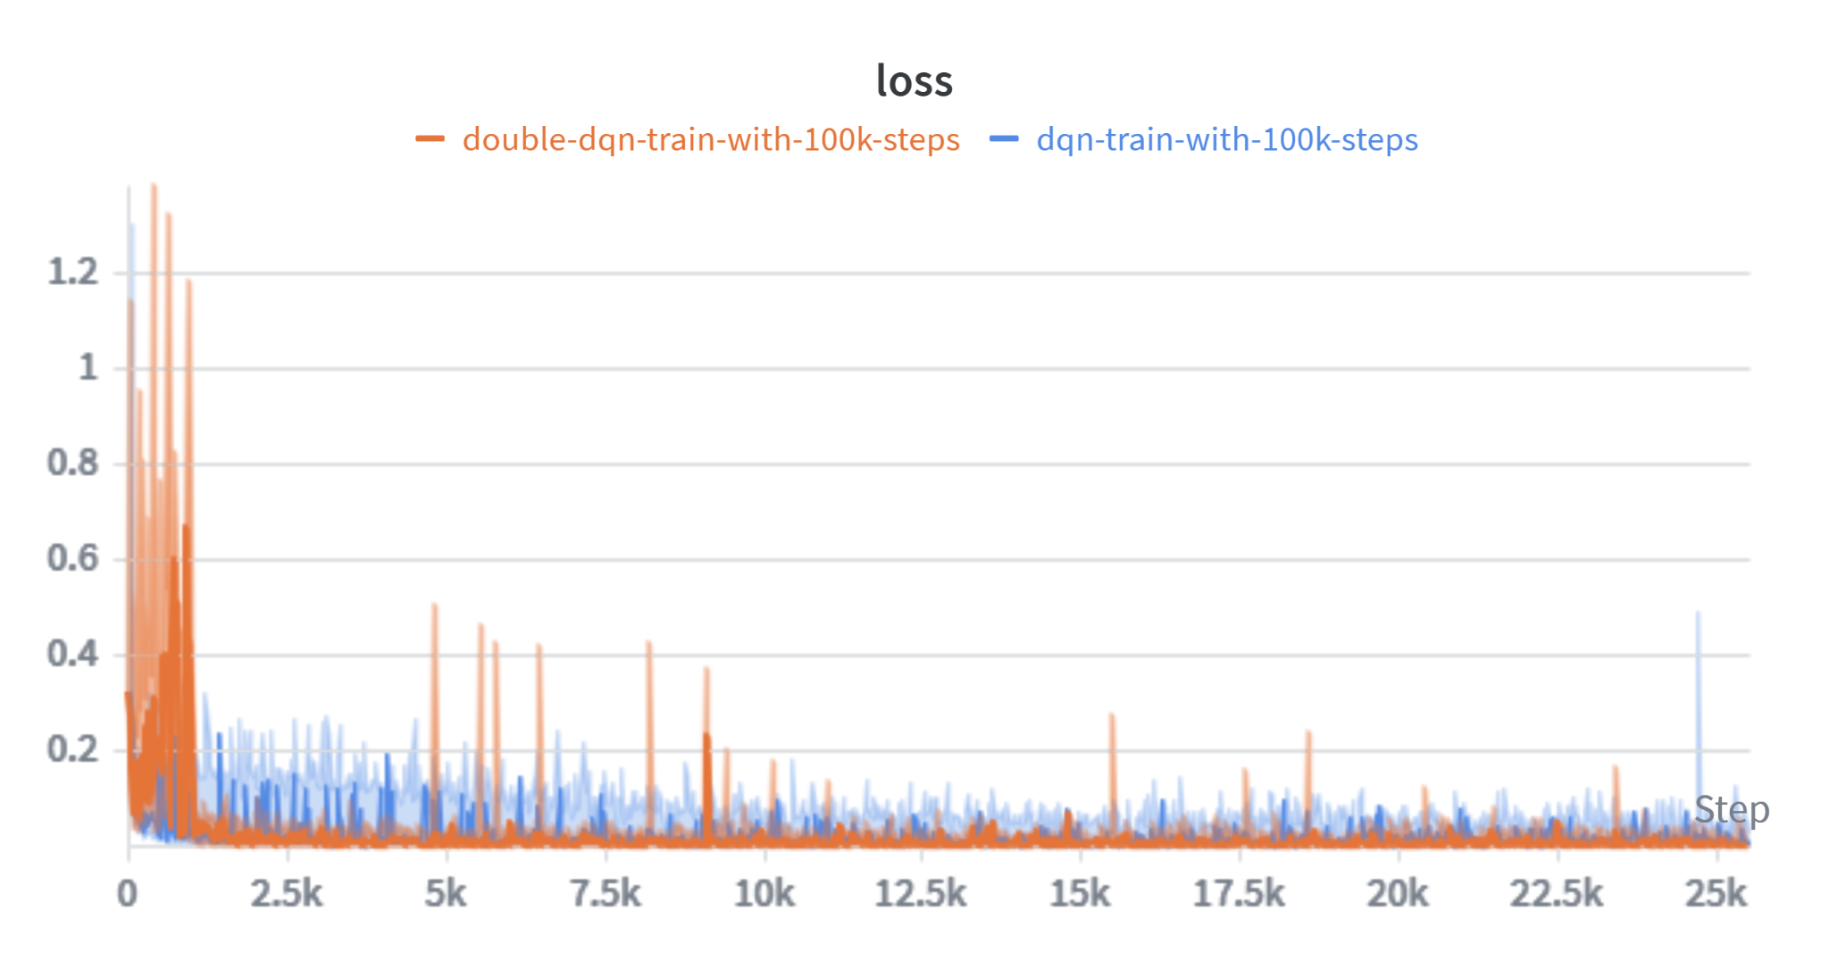
Loss Curves

Slide 18
Results after 100K Steps
Metric | DQN | Double-DQN
Avg. Reward | 2.48 | 2.28
Max. Reward | 8 | 8
Std Dev | 1.69 | 1.28
Loss | 0.010 | 0.003

Slide 19
06
Extended Training (200K Total Steps)
Constant epsilon of 0.1
Step = 100K to 200K

Slide 20
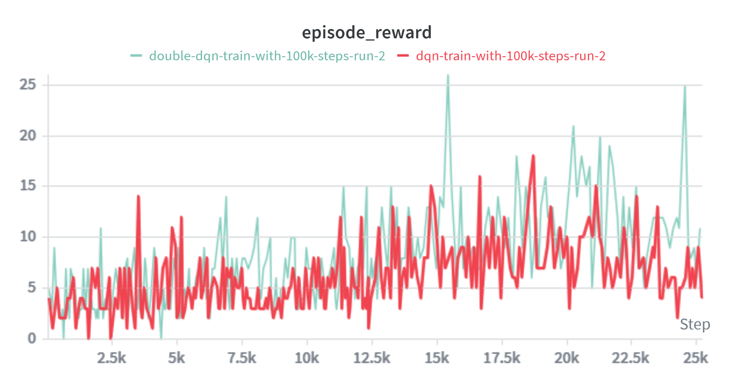
Reward Curves

Slide 21
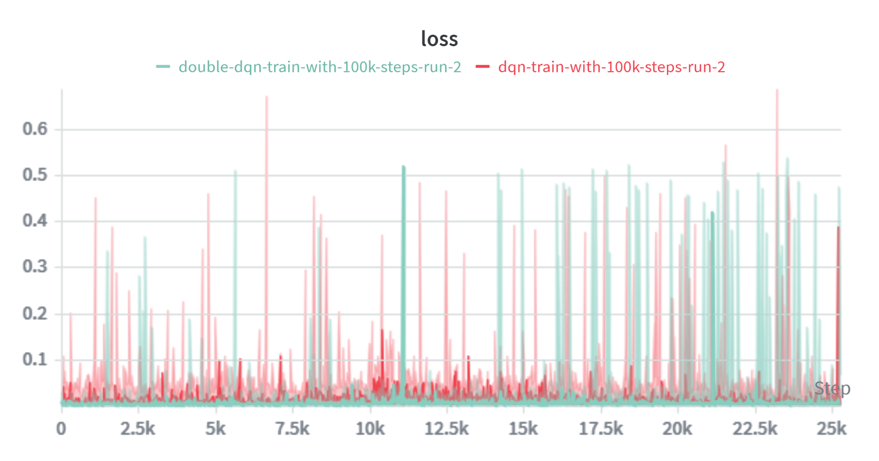
Loss Curves

Slide 22
Results after 200K Steps
Metric | DQN | Double-DQN
Avg. Reward | 7.88 | 11.08
Max. Reward | 18 | 26
Std Dev | 3.04 | 4.05
Loss | 0.008 | 0.002

Slide 23
Improvement
DQN: Avg Reward = 7.88
Double DQN: Avg Reward = 11.08
Double DQN outperformed DQN by ~41%

Slide 24
Analysis and Discussion
DQN and Double DQN similar initially.
Double DQN benefits become visible with longer training.
Double DQN has lower losses throughout training.
Double DQN has higher final rewards.

Slide 25
Conclusion
Successfully implemented DQN and Double DQN.
Double DQN reduced overestimation bias.
Achieved higher long-term performance in Breakout.
Results support the theoretical advantages of Double DQN.

Slide 26
Future Work
Prioritized Replay
Dueling DQN
Longer training runs
Multiple random seeds

